Slide 1


IEEE Kafrelsheikh
Student Branch
Machine Learning Committee

Slide 2

Covid 19

Slide 3

01
introduction
02
visualization
03
the benefits
04
questions

Slide 4
01
Introduction

Slide 5

From World Health Organization - On 31 December 2019, WHO was alerted to several cases of pneumonia in Wuhan City, Hubei Province of China. The virus did not match any other known virus. This raised concern because when a virus is new, we do not know how it affects people

Slide 6
Column Description
Sno - Serial number
ObservationDate - Date of the observation in MM/DD/YYYY
Province/State - Province or state of the observation
Country/Region - Country of observation
Last Update - Time in UTC at which the row is updated for the given province or country.
Confirmed - Cumulative number of confirmed cases till that date
Deaths - Cumulative number of of deaths till that date
Recovered - Cumulative number of recovered cases till that date

Slide 7
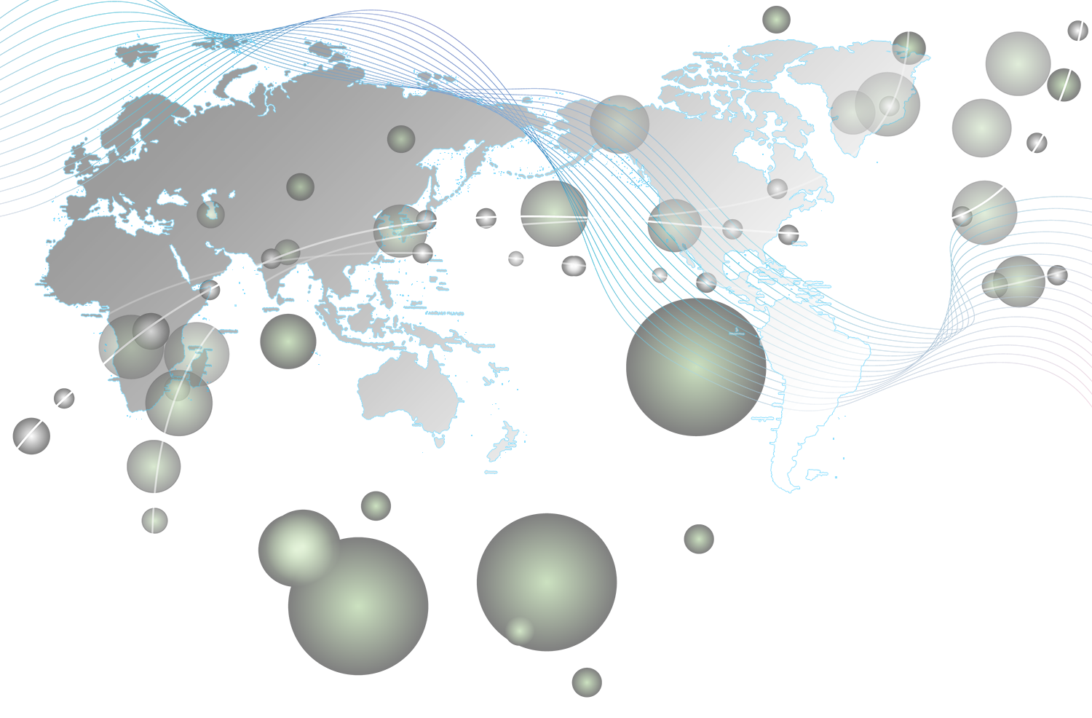

Russia
India
US
UK
Brazil

Slide 8

content
This dataset has daily level information on the number of affected cases, deaths and recovery from 2019 novel coronavirus. Please note that this is a time series data and so the number of cases on any given day is the cumulative number.
The data is available from 22 Jan, 2020.
Contained 60070 row and 8 colunms.

Slide 9
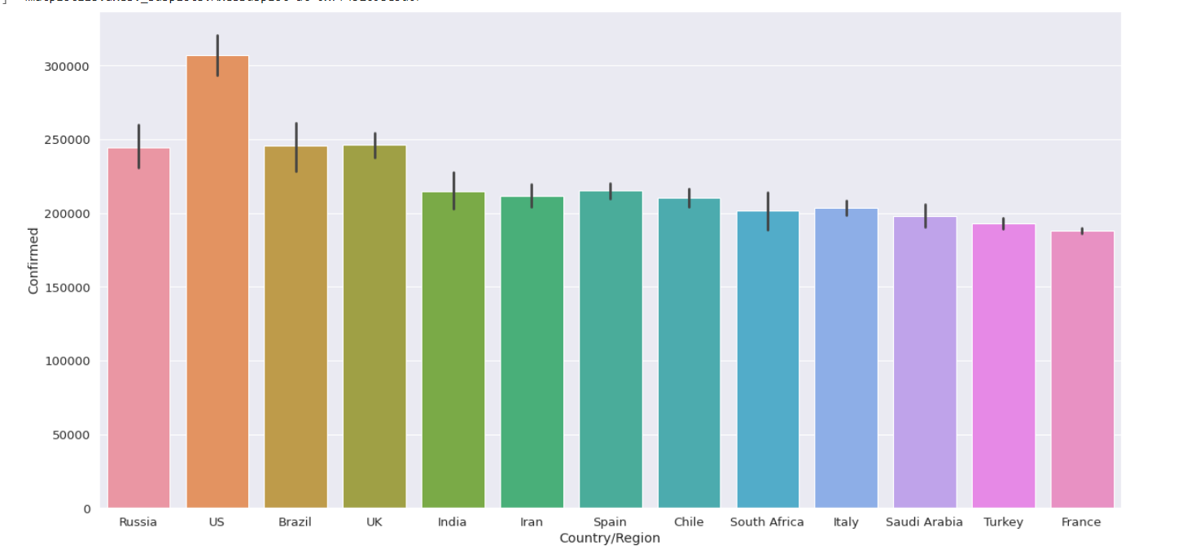
The largest number of countries with confirmed cases:

Slide 10
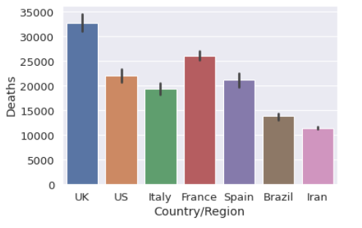
Countries with the highest number of deaths:

Slide 11
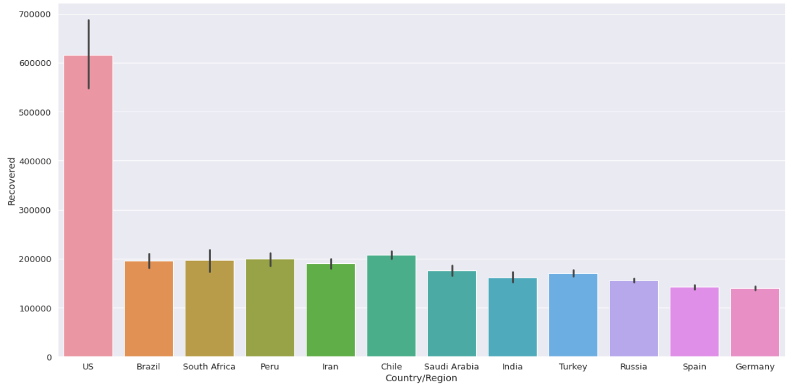
Most countries have recovered:

Slide 12
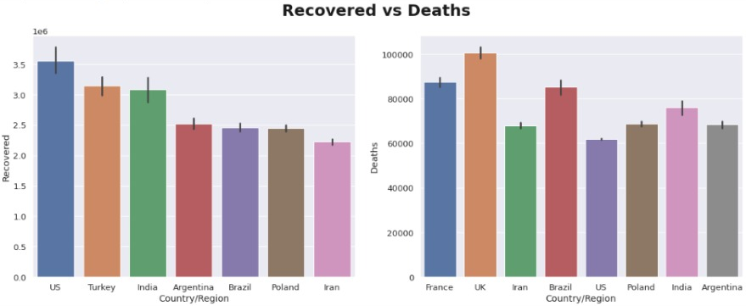
The number of countries in the deaths compared to the recovered:

Slide 13
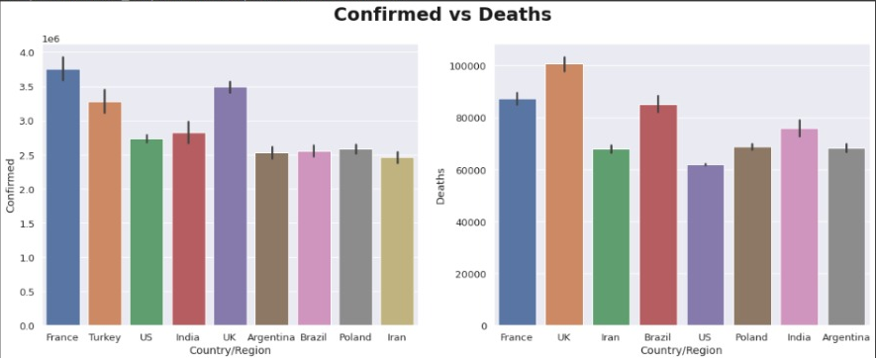
The number of countries in the dead compared to the recovered:

Slide 14
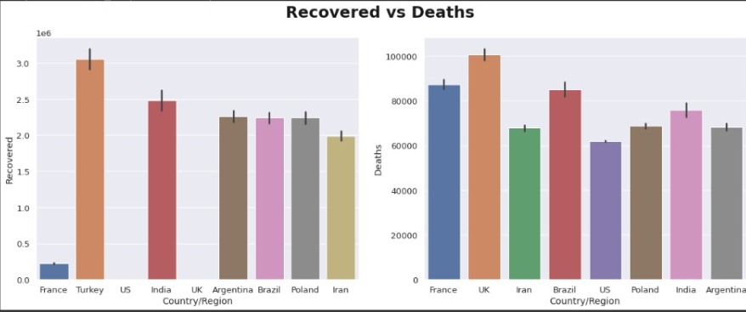
The number of countries in the deaths compared to the recovered:

Slide 15
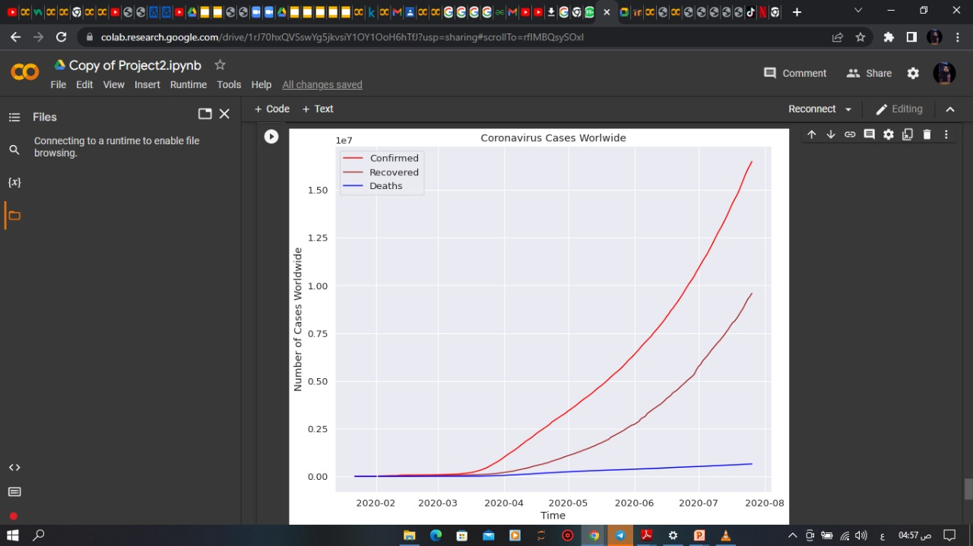
A curve showing the increase in the recovered, confirmed and deaths during the initial period of the corona virus:

Slide 16



Team members
Omnia
Eman
Salma

Slide 17
THANKS

